Slide 1
Multimodal Publishing with Scalar: Part 1
ARL Digital Scholarship Institute
Dan Tracy and Harriett Green

Slide 2
What is Multimodal Publishing?
What do we mean by multimodal publishing?
Digital publications that bring together text with images, video, other media…
…that provide different ways for readers to engage with or navigate the content.
”Multimedia scholarship, although it encompasses many forms, might best be understood as work that refuses the print-digital binary. It is by definition beyond print, even while text often remains a crucial element of such work. It typically includes the following elements: multiple media(text, sound, image, moving images), user interactivity, a networked or database structure, nonlinear components, and a heightened attention to aspects of design, aesthetics, or form.”
McPherson and Anderson

Slide 3
What Does Multi-Modal Publishing Entail?
For scholarship, it enables integration of multimedia evidence in ways not possible in print scholarship and also provides the audience with ways to engage that media.
Related terms: scholarly multimedia, web texts, hypertext
Comparative forms: Exhibits (covered in Omeka session), Digital / critical editions
Also new platforms for more traditional, non multimodal publications like text-only books: Manifold, Pressbooks

Slide 4
History and Common Platforms
Vectors -- > Scalar
WordPress
Drupal / HTML Hand Coding
Fulcrum
Upcoming: Vega

Slide 5
Activity 1: Site Analysis
In groups of 2-3, look at the two multimodal publications assigned to your group.
Identify common features and structures, and issues that you think might be common concerns (in terms of process, information organization, social and legal concerns, technical requirements) with the two different sites.
Also identify some areas where the two sites diverge in these areas.

Slide 6
Core Concerns for Multimodal Publishing: Copyright
Use of in-copyright media (which will include most video/audio media) can pose difficult fair use questions, but there are a number of “best practices” documents available that point to an emerging consensus.
Statement of the Fair Use of Images for Teaching, Research, and Study by the Visual Resources Association
Code of Best Practices in the Fair Use for Visual Arts
Key theme in best practice: use of in copyright works should not be “merely illustrative”; they should be important to the argument (have specific accompanying critical commentary of the specific media or otherwise be clearly necessary to the purpose). “Merely illustrative” = decorative, or easily interchangeable (do I need this specific picture of a dog, or would any dog do?).
Columbia Fair Use Checklist

Slide 7
Core Concerns for Multimodal Publishing: Discovery of Media Content
Where is it?
DPLA, digital repositories, born-digital material online, analog material that needs to be digitized… Any given project may need to draw from multiple sources.
What is the quality of the available digital versions?
The more scholarly and final the expected product (vs. say classroom examples that are not made public), the more likely you need high quality digital versions.

Slide 8
Core Concerns for Multimodal Publishing: Metadata, Data Curation, File Management
What is the quality of the metadata of the digital media you have? Does it need remediation or enhancement?
How are you tracking your metadata and what level of metadata description do you need in the publication itself?
How are you storing your files? Are you following file name conventions?
Use of spaces and special characters in file names can cause buggy behavior in many digital systems, including Scalar!

Slide 9
Core Concerns for Multimodal Publishing: Writing Process
Integrating text and multimedia requires different writing strategies than a normal essay.
Must think through issues of relationship of text and media.
Must think about hypertext navigation of content and not just linear reading of the text when designing organization.
A scholarly publishing platform is not a drafting tool.
A scholarly publishing platform is not a drafting tool.
A scholarly publishing platform is not a drafting tool.
A scholarly publishing platform is not a drafting tool.
A scholarly publishing platform is not a drafting tool.
A scholarly publishing platform is not a drafting tool.

Slide 10
Core Concerns for Multimodal Publishing: Varying Degrees of Technical Difficulty
Out of the box platform? (relatively low overhead; technical difficulties dependent mainly on usability of author interface)
Do you need modifications to an open source platform? (i.e. need to hire a programmer)
Do you need a hand-coded site (even more programming needs)?

Slide 11
Core Concerns for Multimodal Publishing: Sustainability
Who is responsible for updating/maintaining content?
Static publication vs. publication involving content modifications or additions over time
Minimal even for static publications: ensuring links continue to function, media works
Who is responsible for storing the content?
How long should it be available? Who will preserve it? Can it be preserved—or rather in what ways can it be preserved and in what ways can it not?

Slide 12
Intro to Activity 2: Strengths of Scalar
Multimedia integration with text.
Annotation of media.
Creating “paths” through content for readers, supplemented by other ways of interlinking content like tags.
Relatively easy to do these things “Out of the Box” without hiring a graphic designer, web developer, programmer, etc.—though if you could use those people to make something more elaborate.
Flexibility.

Slide 13
Activity 2: Map Out a Multimodal Site for Scalar
Sort through the sample text and media content provided to plan out a site on a topic.
Map out the structure of the site on the large tablet. Use smaller sticky notes to represent different types of content—different colors for different types of content (media, annotation, main body text).
Represent distinct pages by drawing a line around a set of sticky notes.
Represent paths from page to page with arrows.

Slide 14
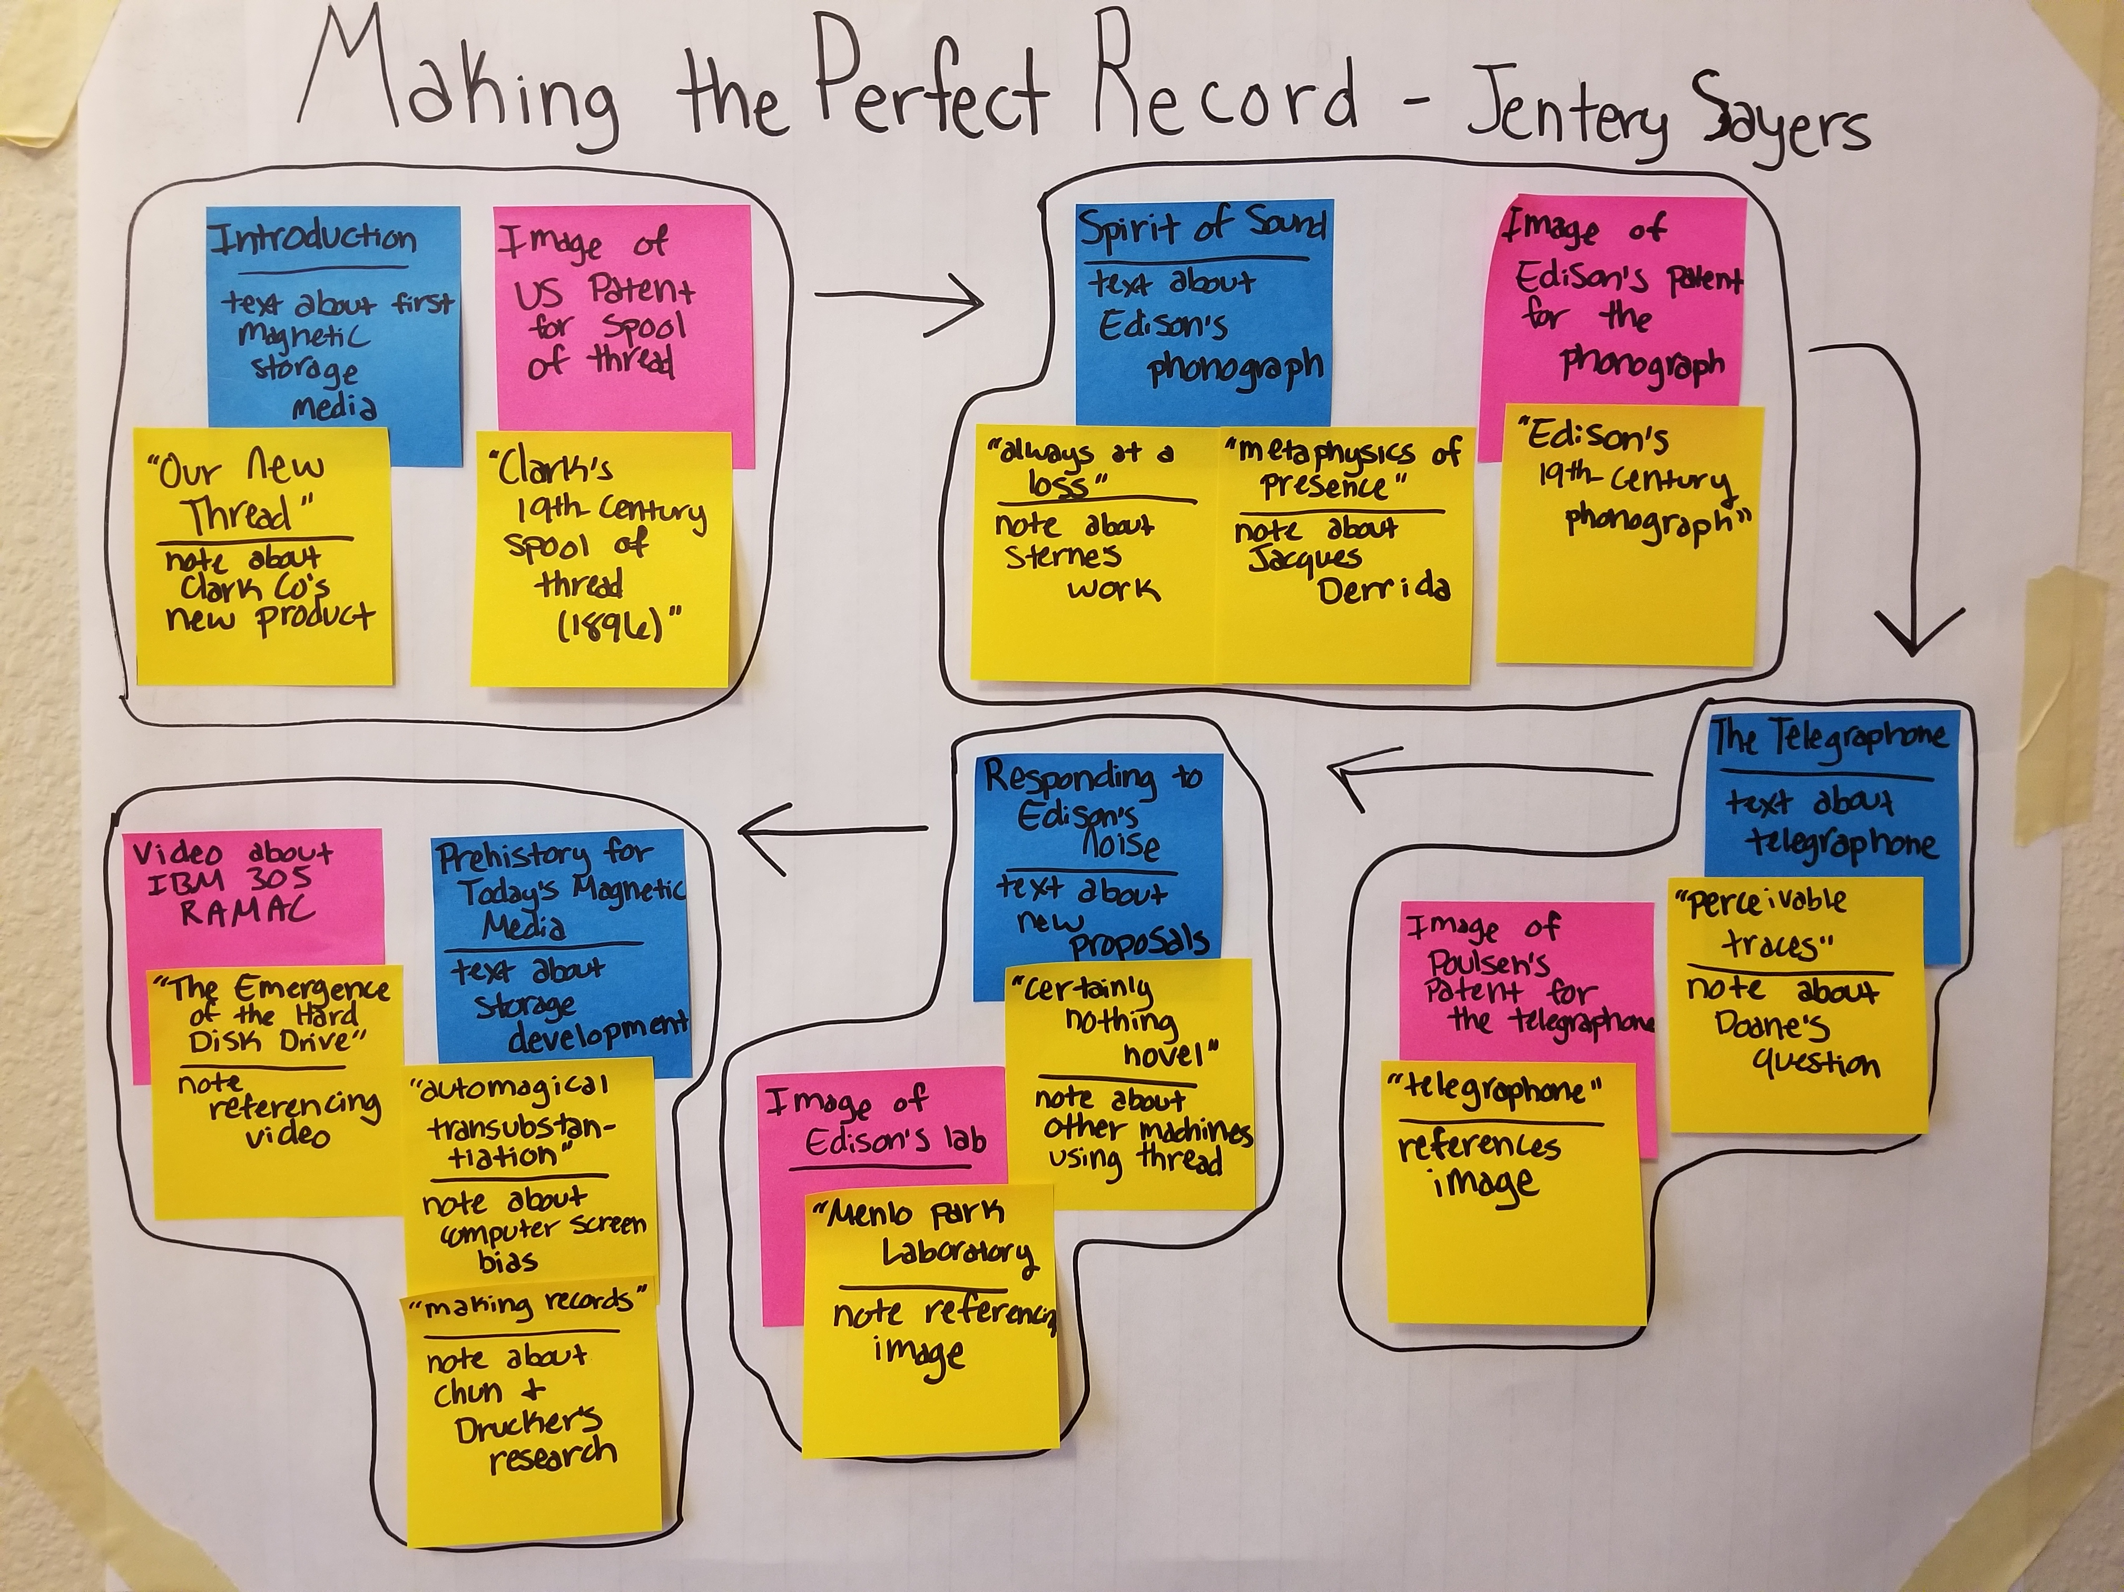
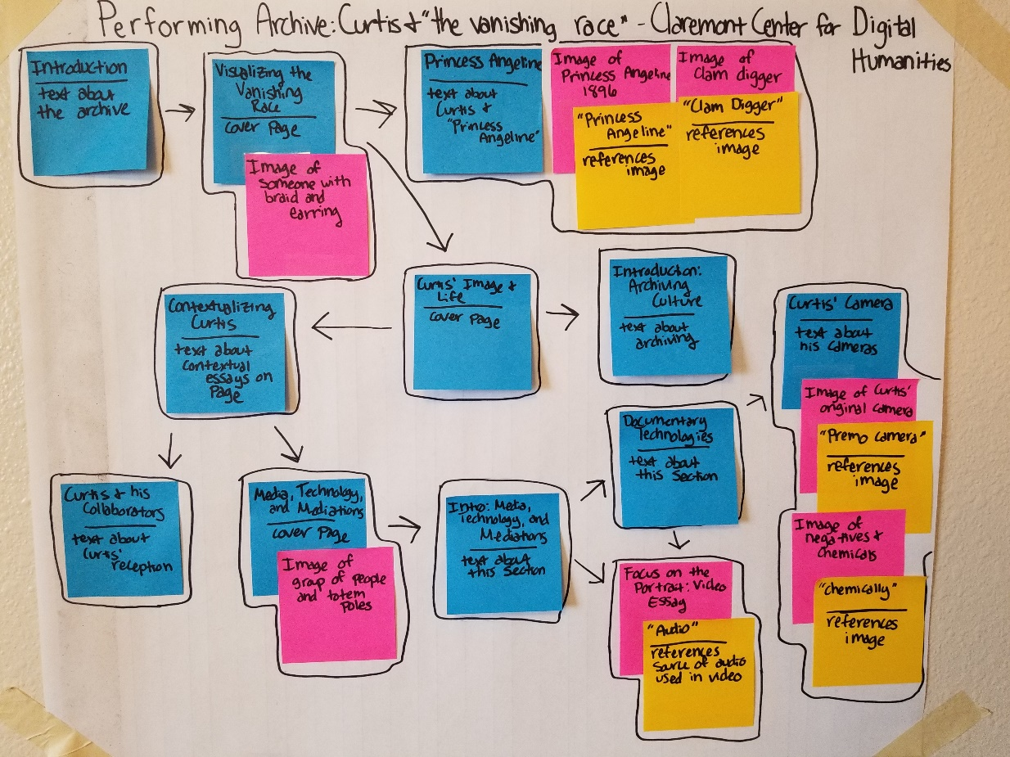
Activity 2: Examples (Yours need not be this tidy!)
In examples: blue = text, pink = media, yellow=annotation. Drawn boundaries represent pages and arrows represent paths. The example on the left represents a simpler single-path essay, whereas the second involves several reader choices about branching off.

Slide 15
Discuss….
How do you feel about your experiences with multi-modal publishing thus far?
Any Questions about process and tools for multi-modal publishing?
Thoughts?

Slide 16

Break!
Please make sure your Scalar account is set up and activated before we return:
http://scalar.usc.edu/works

Slide 17
Multimodal Publishing with Scalar: Part 2
Introduction to Scalar and Building a Multi-Modal Publishing Project

Slide 18
Scalar: What Is It?
EXAMPLES:
https://scalar.lehigh.edu/kiplings/index
http://digitalpaxton.org/works/digital-paxton/introduction?path=index
http://freedoms-ring.org/
http://scalar.usc.edu/works/growing-apart-a-political-history-of-american-inequality/index

Slide 19

Account Set Up
Start using it at: http://scalar.usc.edu/works
Confirm in your email

Slide 20
Multimedia Support: Copyright
Intentional support for integration of multimedia in ways that meets fair use criteria if the material is copyrighted and you have a fair use case.
Rights issues review
Public Domain
Licensed for re-use (Creative Commons or otherwise)
Fair use of copyright-protected works

Slide 21
Site Planning
What are the primary goals of my website?
Who are the primary and secondary audiences?
What sections will the site include?
What will I do with the items on this website?

Slide 22
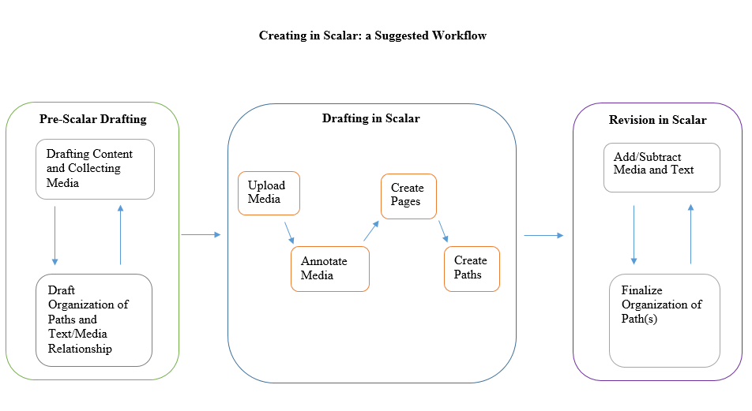
Productive workflow in Scalar?
By Dan Tracy

Slide 23
Source for Data
Use provided example content in "Scalar_Examples.docx":
Text from Wikipedia article, "History of Science and Technology"
List of potential media materials and sources at the end of the document
Select a portion of the text you want to use and then find/download videos, images, etc. from list

Slide 24
Scalar Dashboard

Slide 25
Try It Yourself!
Sign up for a free Scalar account and site at:
http://scalar.usc.edu/works
(click on “Sign UP in the upper right corner)
Scalar User Guide:
http://guides.library.Illinois.edu/scalar

Slide 26
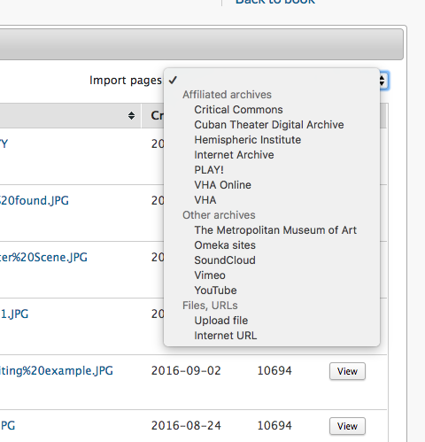
Media Options

Slide 27
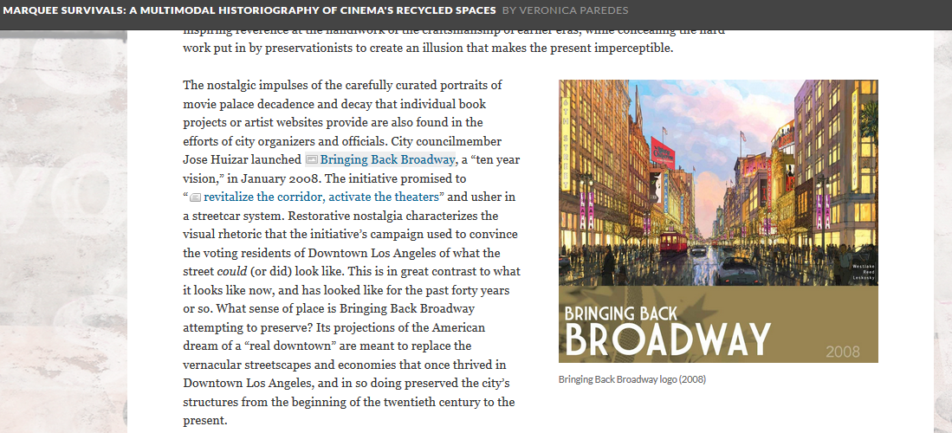
Ways to Use Media In Scalar: Commentary/Critique

Slide 28
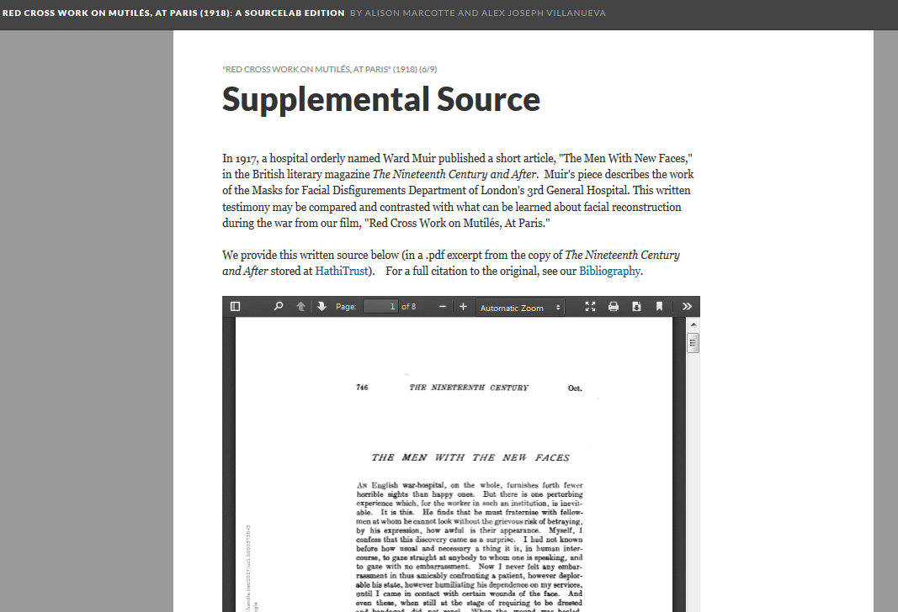
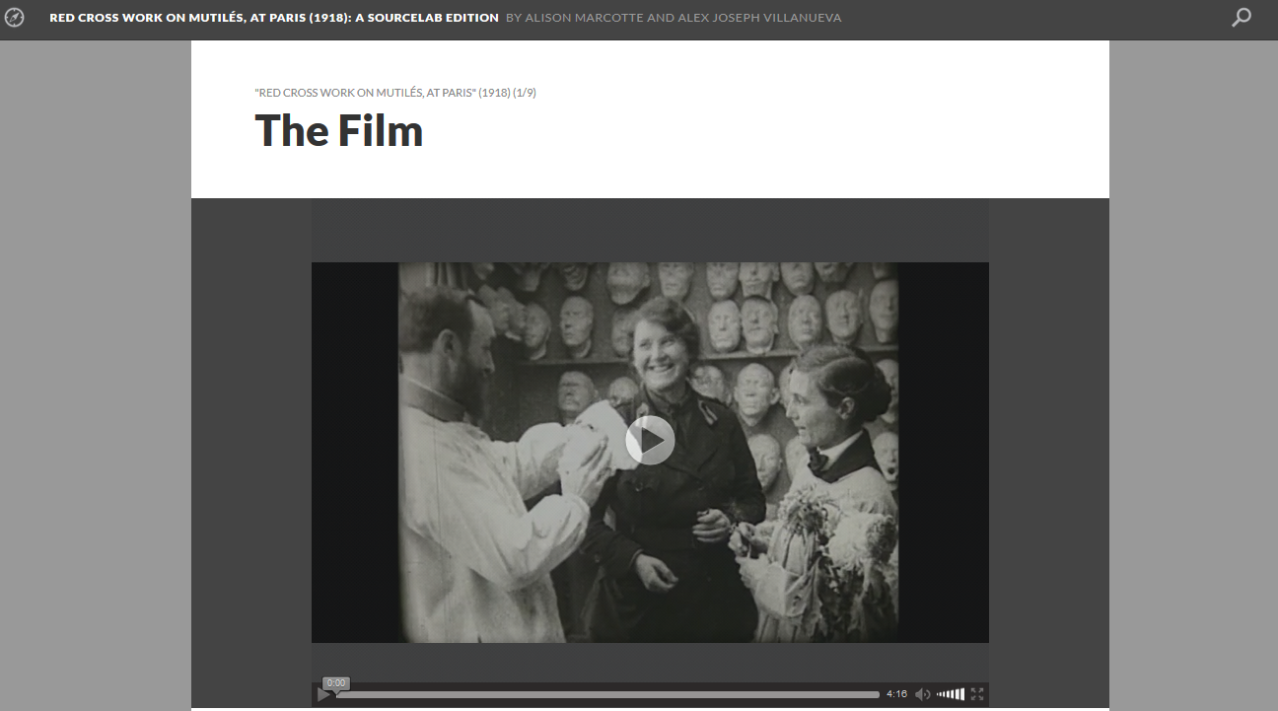
Ways to Use Media In Scalar: Include the Original Text

Slide 29
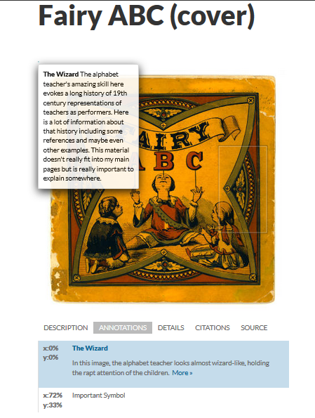
Ways to Use Media In Scalar: Annotation
*“Scholarship” in this annotation totally made up for example purposes!

Slide 30
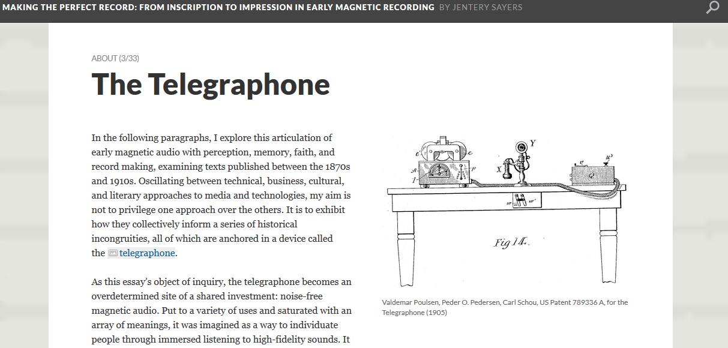
Ways to Use Media In Scalar: Illustration

Slide 31
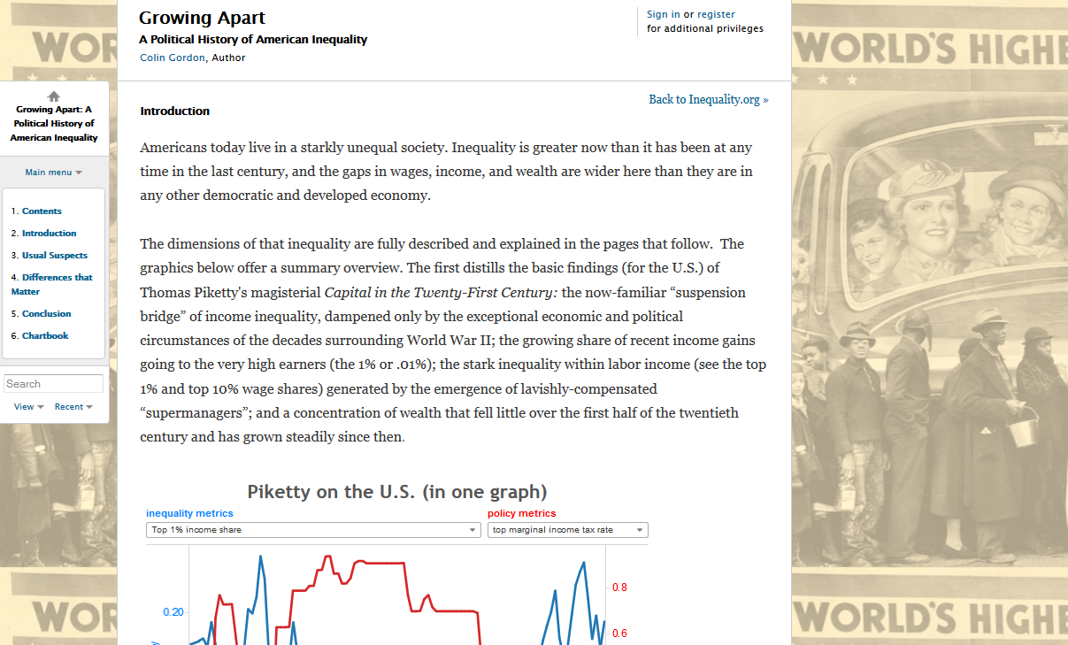
Ways to Use Media In Scalar: Background

Slide 32
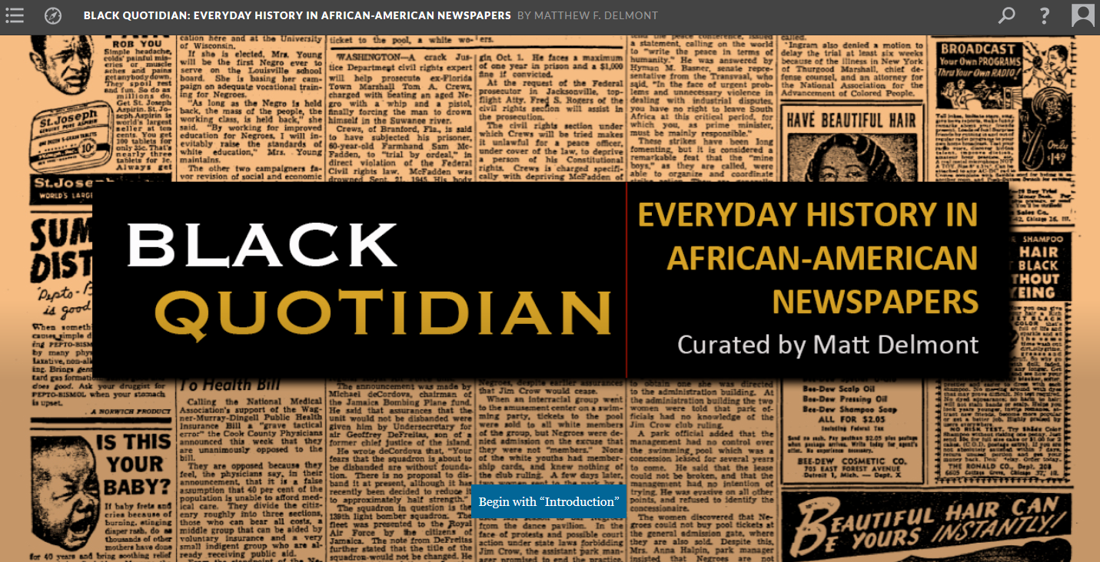
Ways to Use Media In Scalar: Title Page/Splash Page

Slide 33
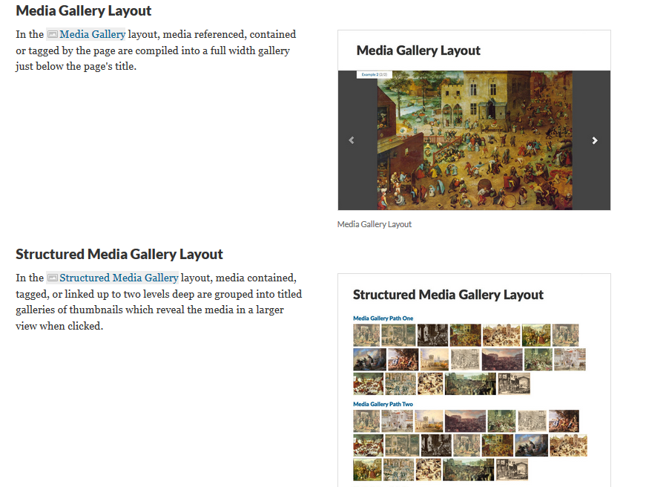
Ways to Use Media in Scalar: Media Galleries

Slide 34
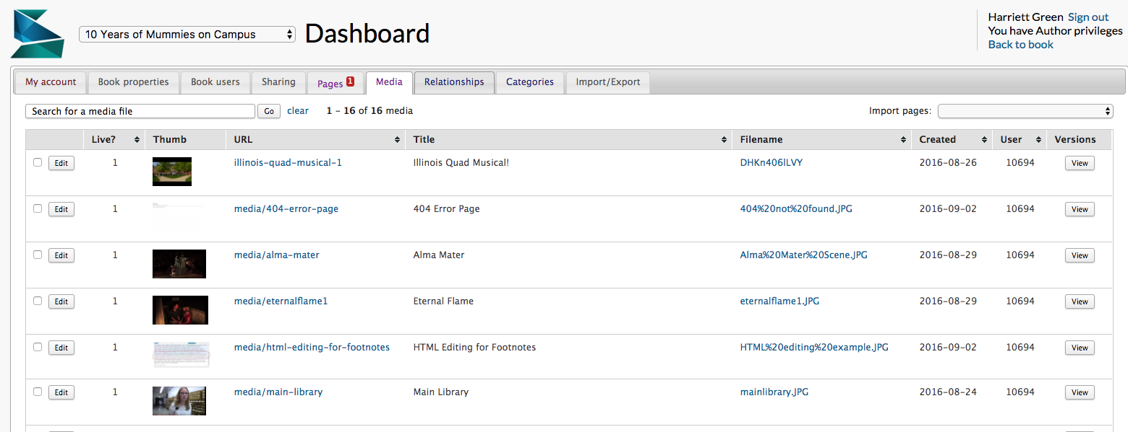
YOUR TURN: Upload media

Slide 35
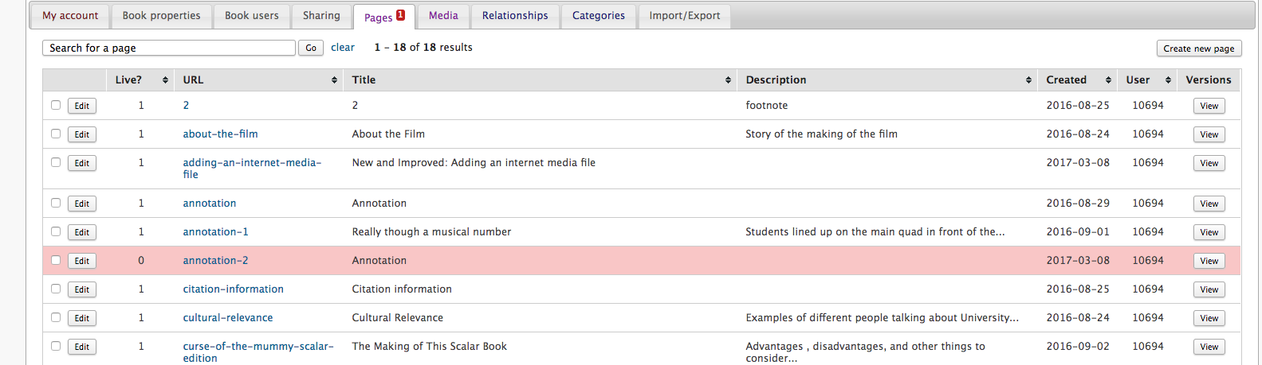
Create a Page

Slide 36
Annotating video
Click on Media tab
Click on the link to the media you want to Annotate
Click on the Edit Annotations button
Click on the plus sign underneath the box to add annotations Select the time markers for the beginning and end of annotation

Slide 37
Structure of a Scalar site
Media
Pages
Paths
Book

Slide 38
Building a Scalar Site
Create a Page
Go to Dashboard
Click on Pages tab
Click on Create a Page
Create a Path

Slide 39
Build Your Scalar Site!
Refer to mapped site from Activity 2
Upload sample text and images from selected digital exhibition to your Scalar site

Slide 40
Build Your Scalar Site
Dashboard (“Index”)
Create Your Book on the My Book tab
Edit URL and look of site
Click on the Menu “Home” icon to get to your Home Page (‘/index’)

Slide 41
Build Your Scalar Site
Create Pages
Click on Pages tab →Click on Create a Page
At the bottom of any page, click on New button
7 different layouts that feature media, embedded maps, and text + media

Slide 42
Build Your Scalar Site
Create a Path
Structure of Scalar book – like a ‘slide show’
Go into edit view of a page
Choose “Make this page into a path”
Can add pages, media objects, and annotations

Slide 43
Explore more in Scalar....
Full Scalar documentation:
http://scalar.usc.edu/works/guide2/index
Support Forums:
https://scalar.usc.edu/scalar/forums/
Our Scalar user guide:
http://guides.library.Illinois.edu/scalar

Slide 44
Discuss…
Lingering questions? What did you takeaway from this experience?
How does Scalar’s strengths and weaknesses compare to any other web publishing tools you may have used before?
What were the challenges with Scalar specifically, and what might be challenges with multimodal publishing projects in general?
How do you see yourself using this in your work/with students and faculty/as a library service?

